Slide 1
BCSE103E-Computer Programming Java
Lecture By,
Dr. Anusooya G/SCOPE
*Note: Content taken from various resources

Slide 2
Syllabus

Slide 3
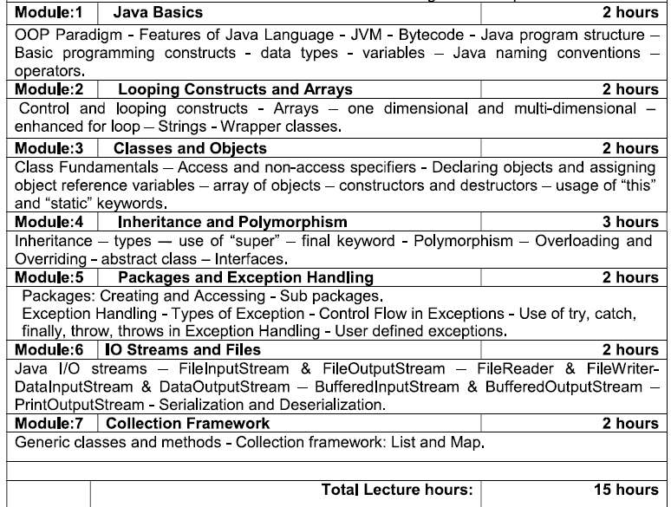

Slide 4
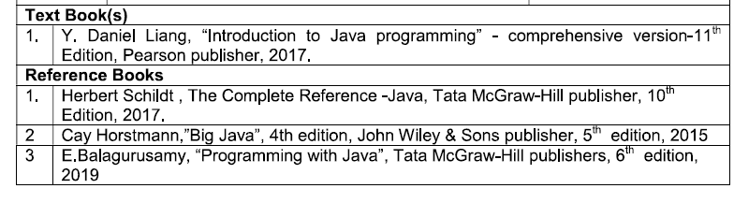
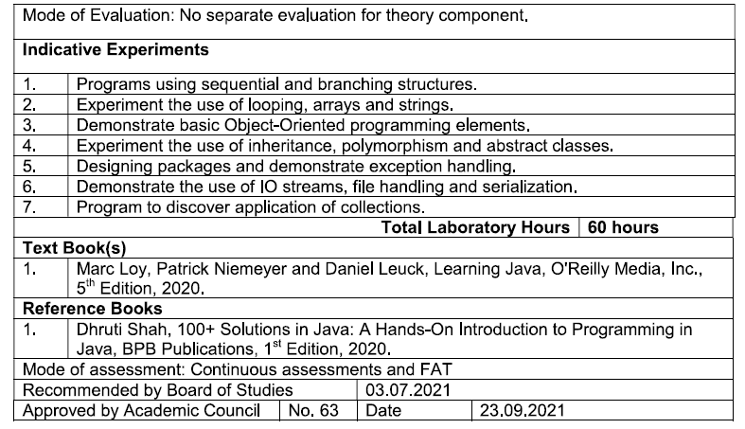

Slide 5
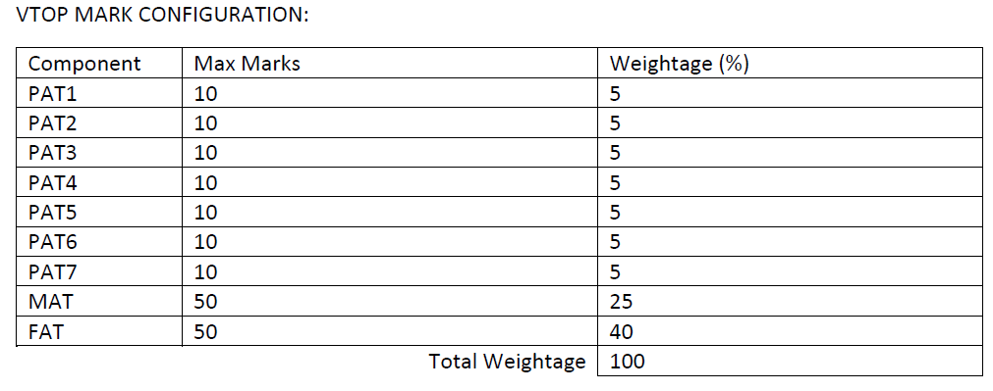
Mark Configuration

Slide 6
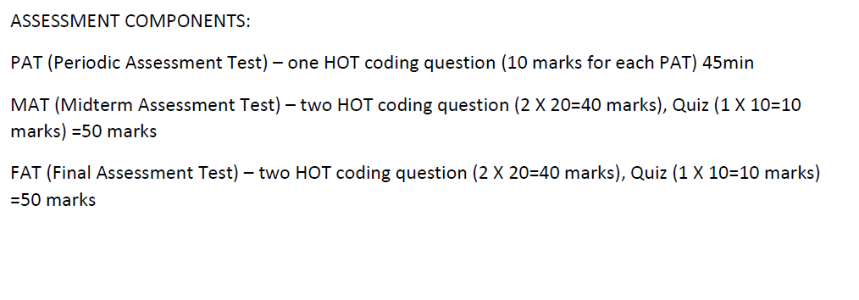
Assessment

Slide 7
Introduction
Java is programming language and a platform.
Java is
high level,
robust,
object-oriented and
secure programming language.
Java was developed by Sun Microsystems (which is now the subsidiary of Oracle) in the year 1995.
James Gosling is known as the father of Java.
Platform:
Any hardware or software environment in which a program runs, is known as a platform.
Since Java has a runtime environment (JRE) and API, it is called a platform.

Slide 8
Java is currently used in…
According to Sun, 3 billion devices run Java.
Some of them are as follows:
Mobile applications (specially Android apps)
Desktop applications
Web applications
Web servers and application servers
Games
Database connection
And much, much more!

Slide 9
Java works on different platforms (Windows, Mac, Linux, Raspberry Pi, etc.)
Java is an object oriented language which gives a clear structure to programs and allows code to be reused, lowering development costs.
Types of Java Applications
Standalone Application
Also called desktop application
Traditional software need to be installed in all machines
AWT and Swings
Web Application
Runs on server side and creates a dynamic page.
Servlets, JSP, Struts, Spring, Hybernate, etc.,
Enterprise Application
Mobile Application

Slide 10
Enterprise Application
An application that is distributed in nature.
banking application
Advantage are high-level security, load balancing and clustering.
EJB (Enterprise Java Bean)
Mobile Application
Exclusively for mobile applications
Android and Java ME is used for creating mobile applications.

Slide 11
Platforms and Editions
Java SE (Java Standard Edition)
Java programming APIs - java.lang, java.io, java.net, java.util, java.sql, java.math etc.
OOPs, String, Regex, Exception, Inner classes, Multithreading, I/O Stream, Networking, AWT, Swing, Collection, etc.
Java EE (Java Enterprise Edition)
Mainly used to develop web and enterprise applications
built on top of the Java SE platform
It includes Servlet, JSP, Web Services, EJB etc.
Java ME (Java Micro Edition)
It is a micro platform that is dedicated to mobile applications.
JavaFX
It is used to develop rich internet applications. It uses a lightweight user interface API.

Slide 12
Let’s Start…
public class DemoMain {
public static void main(String[] args) {
System.out.println("Hello All! Welcome to JAVA Programming.");
}
}
To Execute:
javac DemoMain.java
java DemoMain
Output:
Hello All! Welcome to JAVA Programming.

Slide 13
Why to learn JAVA?
Object Oriented
Platform Independent
Byte code is distributed over the web and interpreted by the Virtual Machine (JVM) on whichever platform it is being run on.
Simple
Secure – Uses encryption standards
Architecture-neutral
Java Runtime Environment (JRE) generates an architecture-neutral object file format, which makes the compiled code executable on many processors.
Portable – Compiler written in ANSI C
Robust – Creates an error prone situation

Slide 14
JVM – Java Virtual Machine
Provides Java runtime environment
It executes the byte code
Platform dependent
It is implemented using JRE (Java Runtime Environment)
What JVM does?
Loads the code
Verifies the code
Executes the code
Provides runtime environment
Class Loader
Memory
Native Method Interface
Execution Engine
JVM Architecture

Slide 15
JRE – Java Runtime Environment
Set of software tools for developing java applications
It provides the runtime env. for JVM
It contains set of libraries and other files that JVM uses at runtime.
JRE
JVM
Set of Libraries
Other Files

Slide 16
JDK – Java Development Kit
It is used to develop JAVA Application.
It contains JRE and Development tools.
JDK is an implementation of any one of the below given Java Platforms released by Oracle Corporation:
Standard Edition Java Platform
Enterprise Edition Java Platform
Micro Edition Java Platform
It contains a complete package to built java application.
JDK
JRE
Development tools
Eg, javac java etc.,
JVM
Set of Libraries
Other Files

Slide 17
Difference between C++ and JAVA
C++ | JAVA
Platform dependent | Platform independent
Used for System Programming | Application Programming
It Supports GOTO Multiple Inheritance Operator Overloading Pointers Call by value and reference Structure and Union Supports Virtual keyword | It Supports Interface Java supports pointer but we cant write pointer program. It has restricted pointer support. Call by Value Threads
It used compiler only It compiles and converts the code into machine code So, C++ is platform dependent | It is both compiler and interpreter Java source code is compiled to generate bytecode Interpreter executes this bytecode during runtime Java is interpreted that’s why it is platform independent.

Slide 18
Up Next….
Basics and Operators
Control Statements
Arrays
Strings
Wrapper Class

